Slide 1

E-WASTE,
THE BASEL CONVENTION,
AND BCRC-EGYPT
(BCRC-Egypt)
Regional Centre for Training and Technology Transfer for Arab States in Egypt
(BCRC-Egypt)
E-Waste Management Forum: Green Business Opportunities
Marrakech, Morocco
23-24 November 2010
Prof. Mostafa H. Kamel
Director, BCRC-Egypt
www.bcrc-egypt.org

Slide 2
TOPICS
Introduction
Nairobi Declaration
BC Programmes for ESM of E-Waste
BCRC-Egypt Activities on E-waste 2007-

Slide 3
INTRODUCTION
Basel Convention (BC) and E-Waste Issue
  The Basel Convention has addressed the issue of e-waste since 2002
    6th Meeting of Conference of Parties (COP-6) in Geneva
    A “flagship” programme under the Convention
  BC Parties’ commitment further strengthened w/ the Nairobi Declaration

Slide 4
Nairobi Declaration On ESM of E-Waste
Theme of COP8 in Nairobi (27 Nov-1Dec 2006) was “Creating Innovative Solutions Through the Basel Convention for the Environmentally Sound Management of Electronic Waste”
The Nairobi Declaration on ESM of E-Waste and Decision VIII/2 were adopted.
Provided the mandate and roadmap for future strategic action in the framework of the Basel Convention → serves as POLICY DIRECTION to Parties

Slide 5
Nairobi Declaration On ESM of E-Waste
World Forum on E-wastes: Ministers, corporate officials, civil-society representatives and other participants explored solutions for advancing the objectives of ensuring the environmentally sound management of e-waste.
COP9 in Bali (June 2008) adopted a work plan for 2009-2011 which a continuation of work already ongoing in BC and new activities:
  Private-public partnerships
  Development of Technical Guidelines on transboundary movement of e-waste
  Implementation programmes for ESM of e-wastes in Asia, Africa, and South America

Slide 6
BC Programmes for ESM of E-Waste
Mobile Phone Partnership Initiative (MPPI)
Partnership for Action on Computing Equipment (PACE)

Slide 7
Mobile Phone Partnership Initiative (MPPI)
Adopted at COP-6 in Geneva, 2002
Participants: Countries, industries and NGOs Achievements: 5 technical guidelines developed -see http://www.basel.int/industry/mppi/documents.html
Pending issues:
  Pilot projects on mobile phone recycling and awareness-raising
  Finalization and adoption of technical guidelines on the transboundary movements of mobile phones (provisionally adopted by COP9)

Slide 8
Partnership for Action on Computing Equipment (PACE)
Adopted: COP9 in Bali, Indonesia, 2008
Participant: Countries, industries and, NGOs, BCRCs, Basel Convention Regional Centres (China, Egypt, Nigeria, Slovakia, Tehran)
Scope: PCs, displays, printers and associated peripherals
Agreed Activities:
  To develop tools (such as Guidelines) and activities on ESM refurbishment and repair, including criteria for testing, certification and labelling
  To develop tools (such as Guidelines) and activities on environmentally sound recycling and material recovery, including facility certification
  To develop and promote pilot schemes for ESM of used and end-of-life computing equipment towards the attainment of the Millennium Development Goals.
  To develop awareness-raising and training programme activities.

Slide 9
Partnership for Action on Computing Equipment (PACE)……Cont.
Operated as Interim Group and Friends of PACE Working Group
Officially operationally since14 Jan 2009 with the First PACE Working Group teleconference
Discussed Programme of Work 2009/2010 (Road Map)
Physical meeting in mid-2009
More involvement of developing countries and CEITs very important
Comments on TOR, more nominations for membership required.

Slide 10
PACE
Project Groups
PACE WG
1.1
Testing, Repair & Refurb.
2.1
Materials Recovery & Recycling
3.1
Collection & Management of U&EoL CE
4.1
Awareness Raising & Training
Established in January 2009
Operating under the BC OEWG
An open forum for all stakeholders
Elaborated: Work plan; ToR; Financial arrangements.
Established 4 Project Groups to implement agreed activities → foundation for development of more detailed work plan

Slide 11
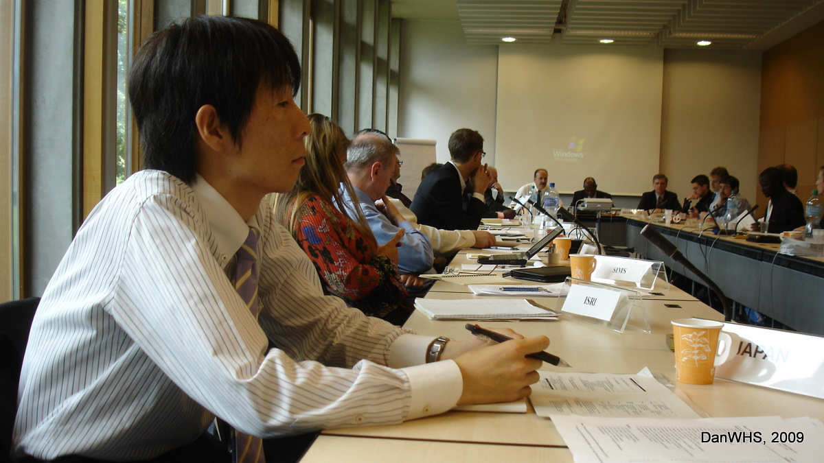
PACE Working Group
1st Face-to-Face Meeting, 18-19.05.2009, Geneva, Switzerland

Slide 12
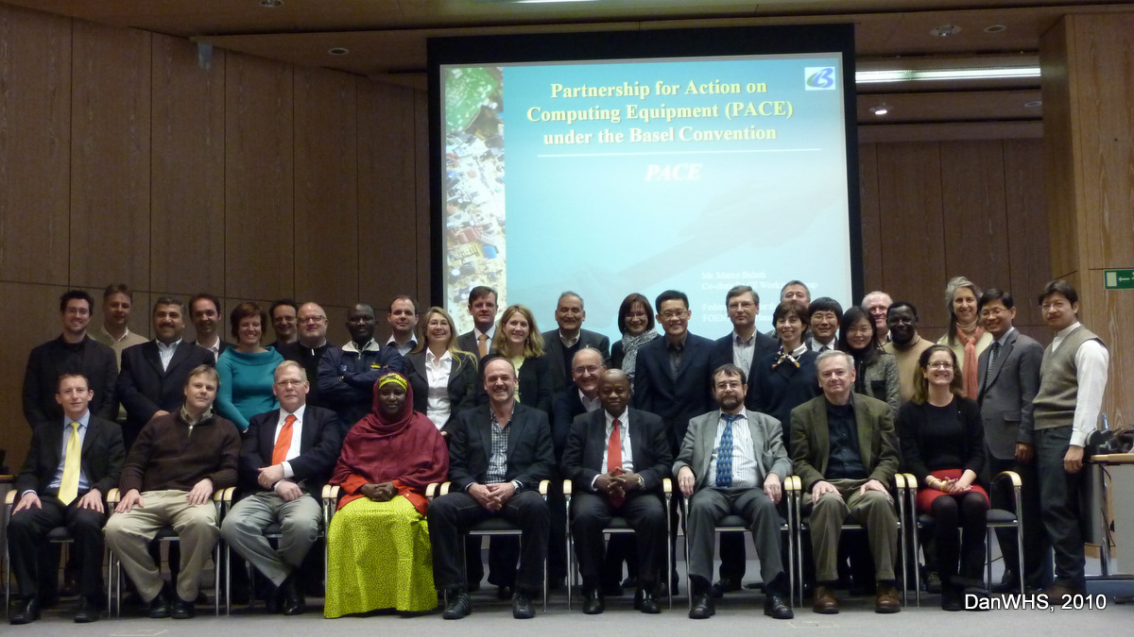
PACE Working Group
2nd Face-to-Face Meeting, 1-3.02.2010, Bonn, Germany

Slide 13
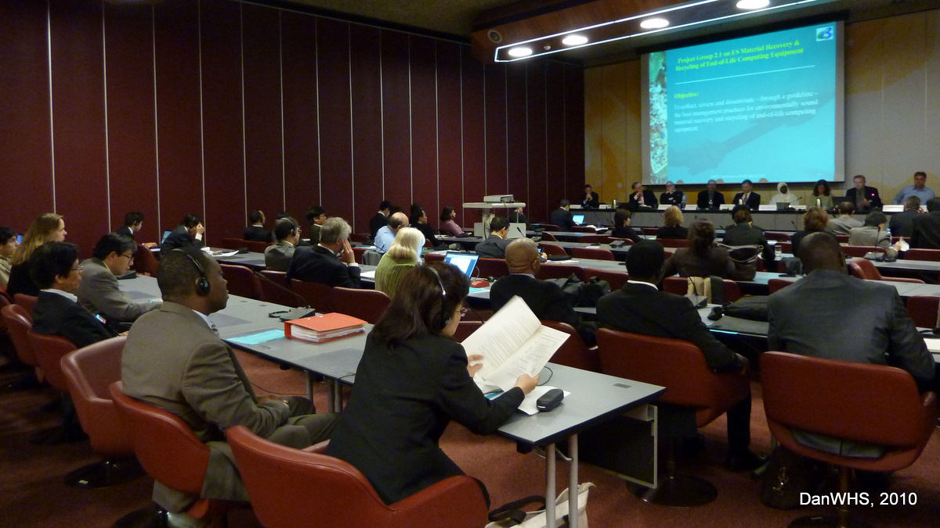
BC OEWG-7 Side Event on PACE
10.05.2010, Geneva, Switzerland

Slide 14
Regional Programme and Partnerships
Asia-Pacific Region
  Launched 2005 with funding from Japan;
  Implemented with BCRC SEA, BCRC China, SPREP
  Wide range of practical activities
African Region
  Initiated 2009 with funding from European Union;
  Implemented with BCRC Senegal and BCRC Nigeria
South American Region
  Pilot project on Inventory of e-waste completed 2006;
  Implemented with BCRC Argentina

Slide 15
Technical Guidelines for ESM of E-Waste
Development of technical guidelines on specific aspects of management of e-wastes is a core part of the regional and partnership work under the Basel Convention:
  E-waste programmes for Asia, Africa and South America
  Partnerships - Mobile Phones (MPPI) and obsolete computer equipment (PACE)
  Work on Technical Guidelines on transboundary movement initiated under COP 9 mandate, emphasising
    Distinction on waste and non-waste of EEE
This work benefits from expertise of national specialists as well as BCRCs and Secretariat

Slide 16
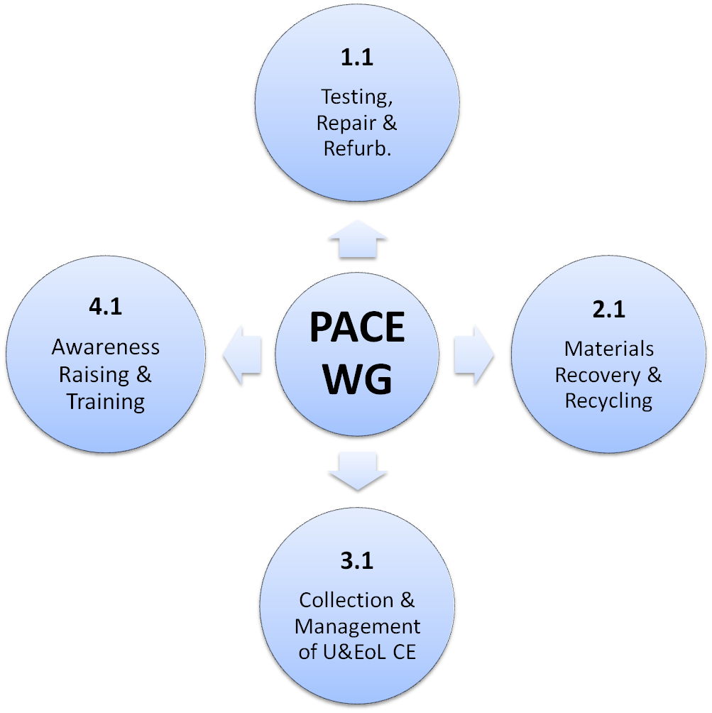
PG 1.1
  Draft TG for ES Testing, Repair and Refurbishment of Used CE prepared
CURRENT ACTIVITIES/PROGRESS
PG 2.1
  Draft TG for ES Material Recovery and Recycling of EoL CE prepared
PG 3.1
  Pilot countries selection criteria developed
  First 4 countries selected for pilot national survey projects
  Pilot projects commencement under preparation
  Sub-group on resource mobilisation and financial sustainability established
  Physical Meeting 14.12.2010, Beijing, China
PG 4.1
  List of awareness raising and training products developed
  Priorities and audiences identified

Slide 17
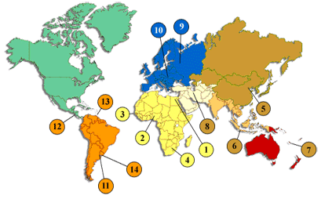
BCRC-Egypt Activities on
E-waste 2007-
BCRC-Egypt serves the 22 Arab States in Africa and West Asia
Framework Agreement
29 / 10 / 2004
Entered into force
22 / 6 / 2005

Slide 18


BCRC-Egypt
Algeria
الجزائر
Bahrain
البحرين
Comoros
جزر القمر
Egypt
مصر
Jordan
الاردن
Syria
سوريا
Kuwait
الكويت
Iraq
العراق
UAE
الامارات
Tunisia
تونس
Lebanon
لبنان
Yemen
اليمن
Qatar
قطر
Somalia
الصومال
Palestinian Authority
السلطة الفلسطينية
Djibouti
جيبوتى
Saudi Arabia
السعودية
Libya
ليبيا
Mauritania
موريتانيا
Sudan
السودان
Morocco
المغرب
Oman
عمان

Slide 19
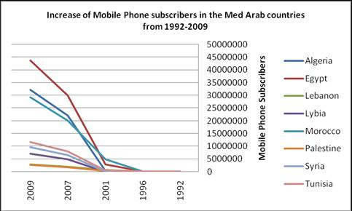
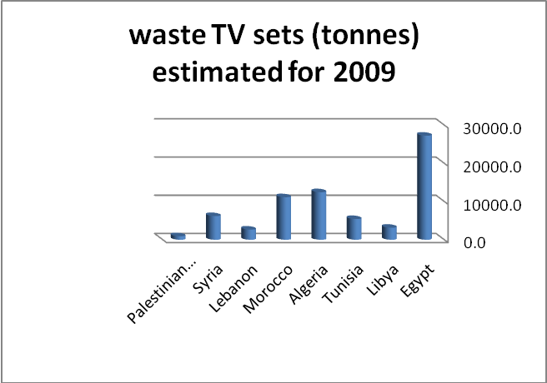
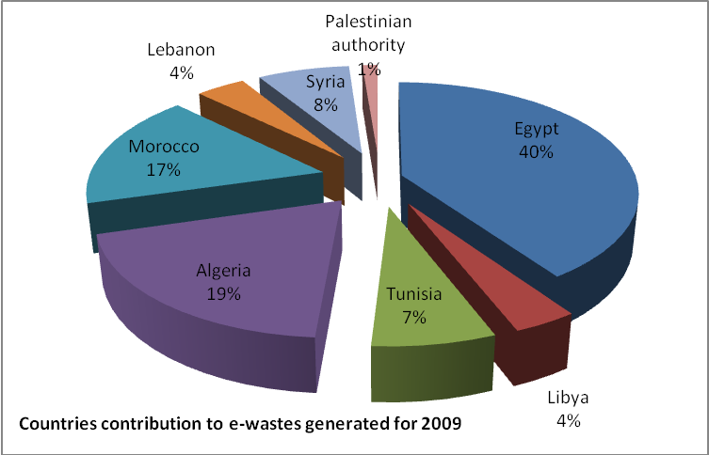
The E-Waste Issue in the Arab Countries
Recently, e-waste became a priority waste among many countries in the region, including Morocco, Egypt, Qatar, Saudi Arabia, Jordan, Tunisia, Kuwait and Algeria.

Slide 20
BCRC-Egypt Response to E-Waste Issue 2007-
Assisting member countries in identify consultants and consulting firms for e-waste management and management planning.
Pilot projects for assessment of E-wastes and E- waste recycling facilities in Algeria, Egypt, Jordan and Saudi Arabia. Funded by the MFA of the Government of Finland
  E-waste training session 12-13/3/2007 → Egyptian Ministry of Trade and Industry issued a decree prohibiting importing personal computers older
  than 5 years (instead of 10 years). Funded by the MFA of the Government of Finland
E-waste awareness through BCRC-Egypt newsletter, media interviews, and newspaper articles by BCRC-Egypt staff. Funded by the MFA of the Government of Finland
Active participation in PACE.
A research project and an e-waste forum initiated by Egypt cleaner production center and regional organization CEDARE; BCRC-Egypt is partner in both initiatives.
Translation into Arabic of MPPI guidelines. Swiss Fund
Assessment of e-waste in the Mediterranean Arab countries in collaboration with BC Focal Points, with contribution from UNEP/MAP.
More activities targeting E-waste envisaged in the 2011-2013 Business Plan.

Slide 21
FURTHER INFORMATION
please contact:
Prof. Mostafa H. Kamel, Director
BCRC-Egypt
Phone +20-2-3567-3567, + 20-2-3567-4836
Fax +20-2-3571-7565
mhk_director@bcrc-egypt.org
www.bcrc-egypt.org

